Slide 1
“Dr. Heidegger’s Experiment”
Nathaniel Hawthorne

Slide 2
Anticipation Guide
In your journals, title the next blank page: “Dr. Heidegger’s Experiment.” Then, respond to the following statements. Do you agree or disagree? Why?
People always learn from their mistakes.
Age brings wisdom.
Young people take things for granted.
You can’t teach an old dog new tricks.
Notes:
This is the question that your experiment answers

Slide 3
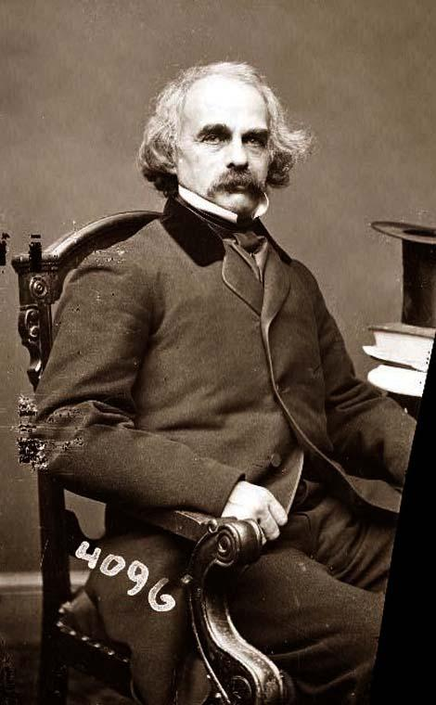
Nathaniel Hawthorne
July 4, 1804 – May 19, 1864
Spent most of his life in Salem, MA
Stories draw heavily on American Puritan History – strict morality
The Scarlet Letter
Painfully shy; known for keeping to himself
Believed that human nature was fundamentally flawed
Friends with Henry David Thoreau, Ralph Waldo Emerson, Edgar Allan Poe…
This Photo by Unknown Author is licensed under CC BY-SA

Slide 4
American Romanticism
First full-fledged literary movement developed in the United States
1820-1860
Influenced by the British Romantics
Also influenced by U.S. history and landscape
Preoccupied with freedom, democracy, and individualism
“The frontier”
Notes:
Summarize your research in three to five points.

Slide 5
Characteristics of American Romanticism
Symbolism
Scarlet “A” in The Scarlet Letter
Individualism
No specific genres in genres
Being true to our identity and essential nature
Non-conformist
Looked to nature for inspiration
Power of emotion
Even it’s irrational, it affects how people see the world
Emotion is a gateway to knowledge
The imagination is the expression of individual identity
Westward expansion

Slide 6
Discussion Questions
What do each of the characters represent?
What are some noticeable objects in Dr. Heidegger’s study? What do these objects tell us about Dr. Heidegger?
What is the mood of the story? Cite diction from the story.
Do you think that the guests actually became young again? Why or why not?
Do you believe Dr. Heidegger is “good” or “bad”? Why?
What is the theme of the story?

