Slide 1
Elements of Fiction
Introduction to Short Story Unit

Slide 2
What is Fiction?
Prose created from the imagination, not presented as fact. It may be based on a true story or situation.
Types of Fiction:
Novel
Novella
Short Story

Slide 3
What are the elements of fiction?
Plot
Setting
Character
Conflict
Point of View
Theme/Message
Literary Devices

Slide 4
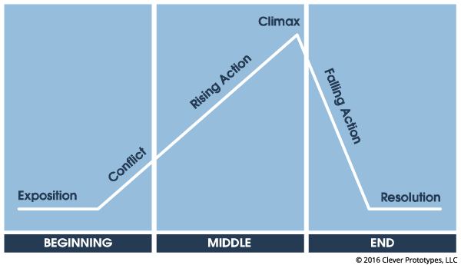
Plot
Plot is the literary element that describes the structure of the story. It shows the casual arrangements of events and actions within a story.

Slide 5
Exposition
Introduction of the characters, setting, and basic situation.
The beginning/start of the story

Slide 6
Types of Characters
Protagonist vs. Antagonist
Dynamic vs. Static
Round vs. Flat
Protagonist = main character
Can be good, but not always
Antagonist = group/person who stands against the protagonist
Not always bad! Might just have something to learn.
Dynamic = experiences important inner change/growth
Static = changes very little throughout the story
Round = well developed and life-like
Realistic emotions
Conflicting feelings
Multiple traits
Flat = one-dimensional
Lacks emotional depth

Slide 7
setting
Time and geographic location within a work of fiction
Initiates the mood of a story
Tone = author’s attitude
Mood = emotional effect on the reader created by the author’s words

Slide 8
Rising action
Series of conflicts that lead to the climax or turning point
Conflict increases to create suspense, interest, and/or tension
Character’s decisions and flaws
Twists and turns

Slide 9
Types of conflict
Conflict is the struggle between opposing forces that drives the action of the story
Internal: Human vs. Self
External: Human vs. Human
External: Human vs. Nature/Supernatural
External: Human vs. Society

Slide 10
Climax
The turning point
Most intense moment of the story
Mental or action
The peak of action
The point of no return
A crisis

Slide 11
Falling action
Point of the story where the conflict decreases
The action that follows the climax

Slide 12
Resolution/Denouement
The conclusion
“The end.”
Tying together all the loose ends
The outcome of the conflict

Slide 13
Point of view
First Person
Third Person
“I” – exists outside of dialogue
Can be any character in the story
Perception/narrator bias
Unreliable narrator
No opportunity for direction interpretation by the author
Author’s attitude and narrator’s attitude are not always synonymous
The author or narrator tells the story
Omniscient
All-knowing
Knows what characters are thinking/feeling
Limited Omniscient = limits knowledge to one character
Limited
Fly on the wall
Limited to reporting what the characters say and do
The reader is a spectator

Slide 14
Theme
The message or insight revealed about life within a literary work.
Seldom stated directly by the author
Must be interpreted by the reader
MORE THAN ONE WORD. (That’s a topic)
Underlying message about the topic

Slide 15
Flashbacks
The current plot is interrupted so that a scene which previously occurred can be shared with the reader
Helps give the reader information about characters or events to be better understood.

Slide 16
Foreshadowing
A warning or indication of a future event
Subtle
EXAMPLE: like storm clouds on the horizon suggesting that danger is coming.
Direct
EXAMPLE: Romeo and Juliet talking about wanting to die rather than live without each other
It adds drama
It adds tension
It creates suspense
It convey information to help the reader understand what comes later

Slide 17
Hyperbole
An exaggeration of ideas meant for emphasis.

Slide 18
Oxymoron
The combination of two contradictory words joined together for a specific effect.
Not the same as a paradox, which combines a contradictory sentence, or group of sentences, that contains an implied truth.
The channel was repeating the old news again and again.
The green pasture surrounded by hills was teeming with a deafening silence.

Slide 19
Parody
An imitation of a work of art or literature.
Give an example of a parody.

