Slide 1
Nonfiction
7th Grade Unit 1

Slide 2
What is NONFICTION?
Prose writing that is based on facts, real events, and real people, such as biography or history.
Biography
Autobiography
Memoir
Journals
Essays
Persuasive
Argumentative
Descriptive
Speeches

Slide 3
Qualities of NONFICTION
Purpose
Elements
Provide information
Express personal feelings
Entertain
Influence
Main Idea
Supported by details/examples
Theme!
Chronological OR logical order

Slide 4
Informational vs. Literary
Informational Nonfiction
Literary Nonfiction
Purpose
To provide factual information
Examples
Science and history texts, encyclopedias, pamphlets, brochures, telephone books, maps, atlases, and most of the articles in magazines and newspapers.
Written to be read and experienced in much the same way you experience fiction.
Different from fiction in that real people take the place of fictional characters, and the settings and plots are not imaginary
Purpose
Share an opinion
Persuade
Describe
Examples
Autobiography, Biography, Essays

Slide 5
Strategies for reading nonfiction:
Preview the selection
Look at the title, headings, charts, etc.
Determine the organization
Separate facts and opinions
Ask questions as you read.
Why did things happen the way that they did?
How did the people involved feel?
What is the writer’s opinion? Do you share this opinion?
Try to make predictions as you read.
Evaluate what you have read.
Ongoing process
Form opinions about people, events, and ideas that are presented.

Slide 6
What is a MEMOIR?
A sub-genre of autobiography
PART of the author’s life, not their whole life.
1st person point of view
Truthful
Contains THEME
Focuses on the author’s relationship to a specific person, place, object, or animal.
Memory, thoughts, and feelings.

Slide 7
Strategies for reading a memoir:
Recognize the Author’s Experience
Connecting to the Author’s Experience
What is happening / what are the events?
What is the author’s experience with the events?
How does the author feel?
Have you experienced emotions or reactions like the author’s?
How were your experiences the same or different?
How does your connection to the author's emotions, reactions, events, or experiences help you better understand the memoir?

Slide 8
“Shooting an Elephant”
by George Orwell

Slide 9
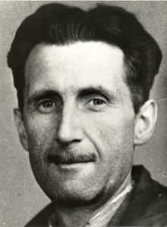
Who is GEORGE ORWELL?
Most known for his novels Animal Farm and 1984
Anti-totalitarian
Real name: Eric A. Blair
Born on 25 June 1903 in Motihari, Bengal, a British colony in what is now India.
Eric's father worked in the Indian Civil Service (the arm of the British government that ran the colony) overseeing opium exports to Asia.
Mother moved back to England in 1904
Dropped out of college and took the entrance exam for the Indian Imperial Police
British colonial force
Posted in Burma in 1922

Slide 10
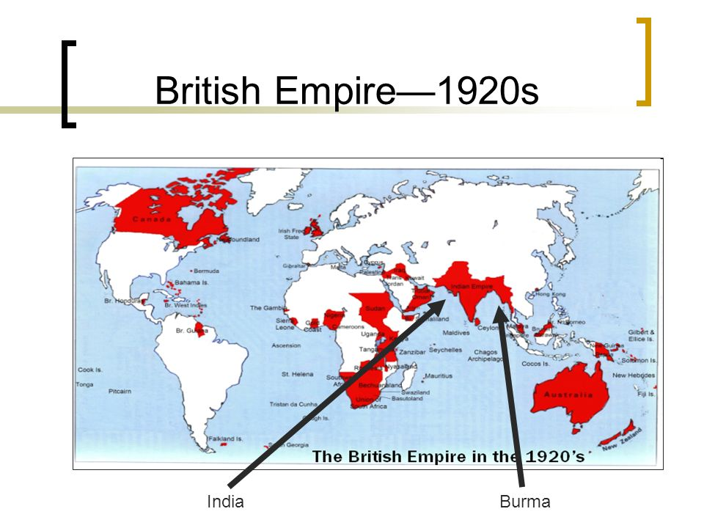
Burma

Slide 11
British Empire
Burma was a sovereign kingdom prior to British intervention.
After 3 wars, the country fell under British control in 1885.
Gained independence in January 1948.
Orwell was disillusioned by the British colonial system from his experiences as an officer.
Corruption and prejudice.

Slide 12
“Shooting an Elephant”
1936
Autobiographical essay
Memoir
What is a symbol?
What is a metaphor?
What is a paradox?

Slide 13
“Shooting an Elephant”
What evidence to Orwell share to prove the existence of “anti-European feeling”?
Why does describe this sentiment as “petty”?
How does Orwell convey the hatred of the Burmese?
Why is Orwell conflicted about imperialism?
Why can’t he express his dislike for the Empire?
What feelings are “normal by-products” of imperialism?
What does the elephant do that Orwell is called into action?
What conclusions are drawn about the elephant?
Why are the Burmese interested in the elephant?

Slide 14
“Shooting an Elephant”
Why does Orwell change his mind regarding shooting the elephant?
Why does he start the paragraph of “but”? What does it add to the structure of his argument?
What is the paradoxical insight Orwell arrives at regarding British Imperialism?
Why does Orwell say: “when the white man turns tyrant it is his own freedom that he destroys”?
What factors does Orwell consider when debating whether or not to kill the elephant?
How do the reasons Orwell gives for not shooting the elephant reflect the deeper motives behind imperialism?
Is Orwell afraid? If so, what is he afraid of?

Slide 15
“Shooting an Elephant”
Why does Orwell take so long to describe the death?
What is the reaction to the killing?
How does Orwell use reason and emotion to move the reader about the tensions within colonialism?
Why did Orwell write “Shooting an Elephant”?

Slide 16
What is a THESIS STATEMENT?
The declaration of purpose.
The main idea
Your stance or assertion
Telling the reader where you are going in the following paragraphs
NOT an announcement
“I am going to talk about…” – DON’T DO IT!
Always ask yourself…
Is my thesis specific? Will my reader be prepared for what they’re about to read?
SO WHAT?!

Slide 17
YAY or NAY?
Education is good.
The North and South fought the Civil War for many reasons, some of which were the same and some different.
It’s a good idea to wear uniforms at school.
The theme of Harry Potter is that good is better than evil.

Slide 18
How should you SUPPORT your thesis?
Evidence from the text
Outside research
Personal experience
Use carefully
Try not to make generalizations or stereotypes

Slide 19
Thesis Statement Practice
Students should read classic literature in school.
Grammar should not be taught in school.
Students should only attend school 4 days a week.

Slide 20
“Shooting an Elephant”
What is George Orwell’s argument?
What would be Orwell’s “thesis statement”?
Do you agree or disagree with his thesis statement? Why?

Slide 21
"The Night the Bed Fell"
by James Thurber

Slide 22
IRONY
Irony is usually directed at a situation and isn’t meant to hurt others.
Merely an observation about the ridiculous situations people find themselves in.
It is a contradiction between appearance/expectation and reality.

Slide 23
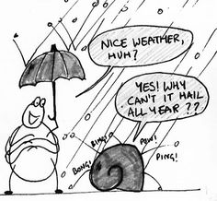
Verbal Irony
Most common form of irony
Meant to be obvious difference between what the speaker says and what they mean.
Saying the exact opposite of what they mean.
Sarcasm; wit.

Slide 24
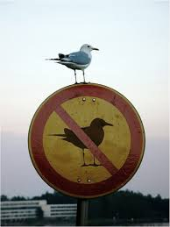
Situational Irony
Created by events rather than words
The people involved may not understand.

Slide 25
Dramatic Irony
When the audience knows more than the characters do.
The actions and words of the characters mean different things to the reader/audience than they do to the character himself/herself.
Generates curiosity among the audience.
Hope, fear, and anticipation.

Slide 26
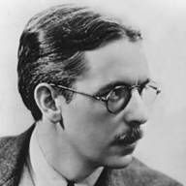
James Thurber (1894-1961)
American writer and cartoonist who grew up in Columbus, Ohio
Like Orwell, did not finish his degree
Attended Ohio State University 1913-1918
Writings and drawings depicted the urban man who one "who escapes into fantasy because he is befuddled by a world that he neither created nor understands" (Britannica)
Known for "The Secret Life of Walter Mitty"

Slide 27
Discussion Questions
What is Thurber's purpose in writing this essay?
How does Thurber organize the essay?
Why do the characters behave the way that they do?
How would you describe Thurber's relatives using a descriptive adjective?
How does Thurber's diction contribute to the humor of the essay?
Contrast what actually happens when the bed falls with what each character thinks happens.
What is the theme of this essay?

Slide 28
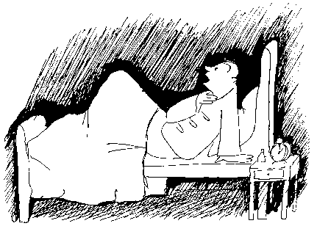
"The Night the Bed Fell"
What objects do you notice?
What do you think they symbolize?
What scene does this depict in the story?

