Slide 1
The Charge of the Light Brigade
Alfred Lord Tennyson

Slide 2
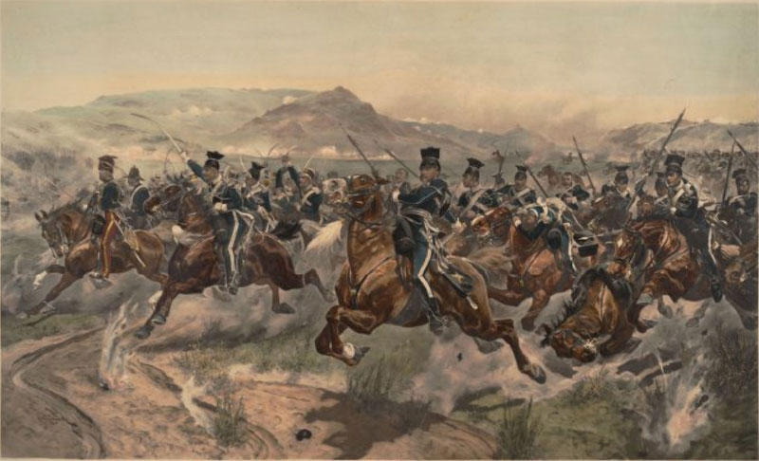

Slide 3
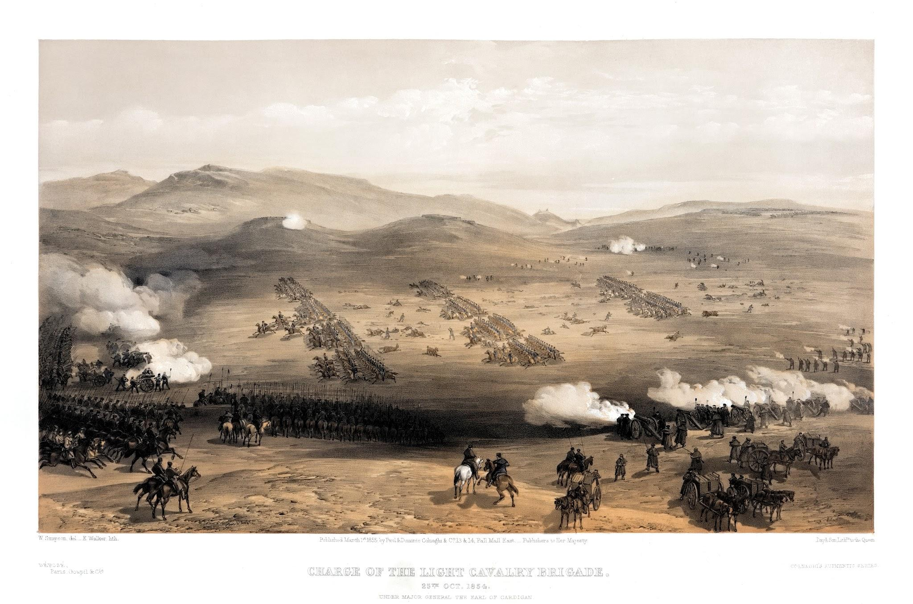

Slide 4
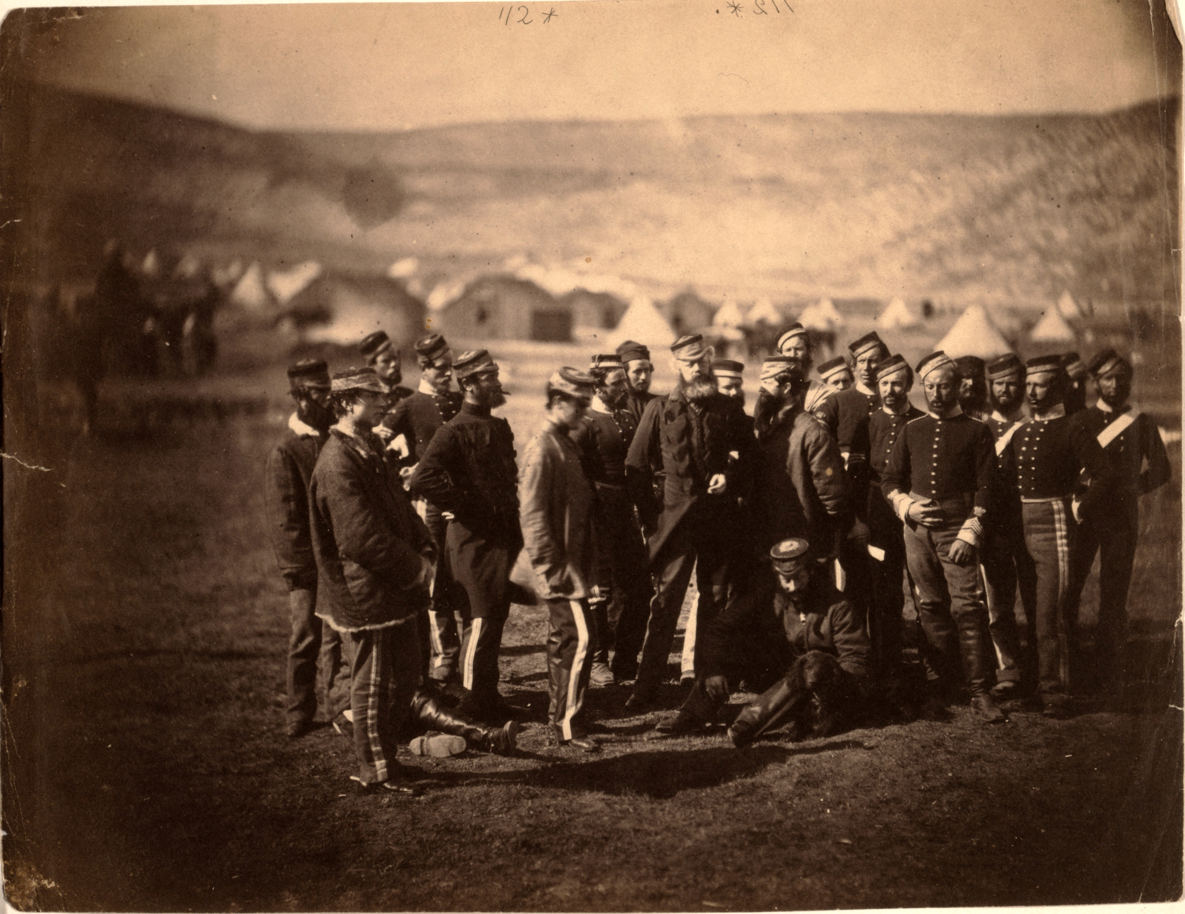

Slide 5
Crimean War, 1854
Russian Empire vs. Britain, France, Sardinia, Ottoman Empire
Who would have dominant influence in the declining Ottoman Empire
The Charge of the Light Brigade took place during a battle near the city of Balaclava on October 25, 1854.
On October 25, 1854, the commander-in-chief of British troops issued an ambiguous order that his subordinates misinterpreted, resulting in the battle against a heavily defended Russian position.
Facing artillery and musket fire on three sides, British cavalrymen were killed as they galloped down the “valley of death.”
Because they maintained discipline amid the chaos and even managed to briefly scatter the Russians, the British public glorified them.
In the end, of the roughly 670 Light Brigade soldiers, about 110 were killed and 160 were wounded
When news of the action reached London, it caused a national scandal that prompted Tennyson to pen his poem. History remembers the charge of the Light Brigade as an example of the extraordinary bravery of the British soldier in the face of enemy fire in spite of poor leadership.

Slide 6
