Slide 1
The Hero’s Journey
Classical mythology

Slide 2
Archetypes
Joseph Campbell studied mythologies across the world
Discovered that many cultures’ myths follow specific patterns in characters and plots.
Archetypes
Images and ideas that appear in mythologies across the world
They show up in religion, fairy tales, fables, AND myths
Common Archetypes
Mother/Father Figure
Hero
Wise Old Man
Maiden
Witch/Wizard
Trickster

Slide 3
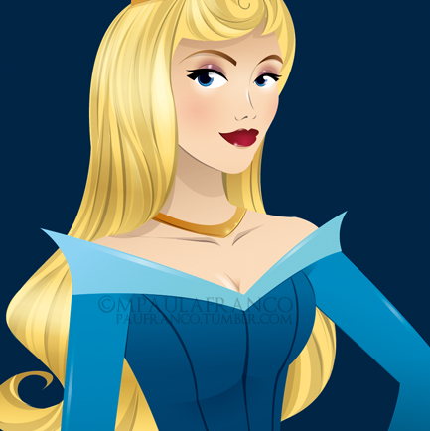
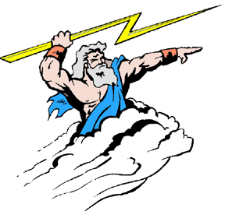
This Photo by Unknown Author is licensed under CC BY-NC-ND
This Photo by Unknown Author is licensed under CC BY-SA
This Photo by Unknown Author is licensed under CC BY-NC-ND

Slide 4
Hero’s Journey
Type of Archetype
“Quintessential” (best example) of an archetypal myth.
It outlines the steps a character will likely take on his/her path to becoming a hero.

Slide 5
Popular examples of the hero’s journey
Lord of the Rings
Harry Potter
Kung Fu Panda
Spiderman
Finding Nemo
So many more…

Slide 6
3 Parts to the Journey
Departure
Initiation
Return

Slide 7
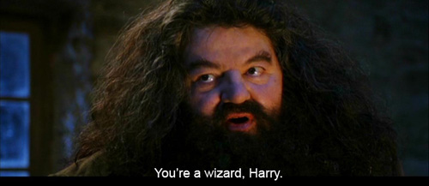
Part i: The Departure
An Unusual Birth/Childhood
Sets him/her apart
This Photo by Unknown Author is licensed under CC BY

Slide 8
Part I: The Departure
Call to Adventure
Spur to action
Forced to leave everyday world/life
May at first reject the call; acceptance is hero’s first voluntary step

Slide 9
Part I: The Departure
Crossing the threshold
Boundary between the life the hero has known and the challenges that await.
Uncertainty and danger lie ahead
Setting off on the journey

Slide 10
Part II: Initiation
Challenges and Trials
Supernatural Helper/Mentor
Special Weapon
The Abyss or Temptation
The Transformation

Slide 11
Challenges/Trials
Makes up the majority of the journey
Obstacles, monsters, and battles the hero must fight in order to complete the journey.

Slide 12
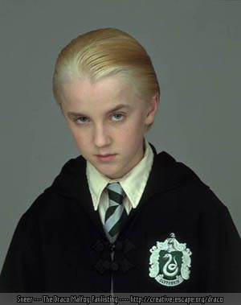
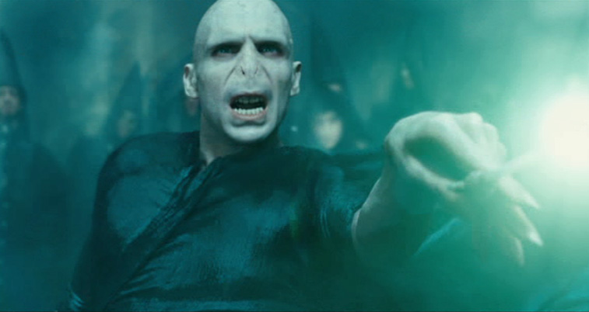
Harry Potter’s Challenges/Trials
This Photo by Unknown Author is licensed under CC BY-SA
This Photo by Unknown Author is licensed under CC BY-NC-ND
This Photo by Unknown Author is licensed under CC BY

Slide 13
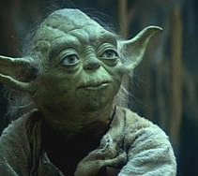
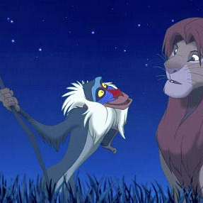
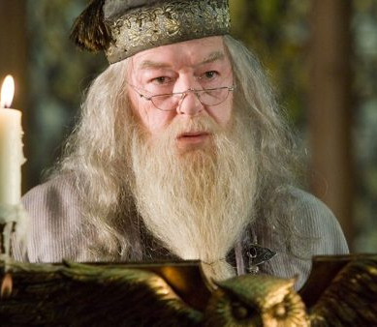
Supernatural helper/mentor
Advice and guidance
Might provide weapon or magical object
Mentor has to “leave” in order for the hero to come to his/her own and show his/her worth
This Photo by Unknown Author is licensed under CC BY-SA
This Photo by Unknown Author is licensed under CC BY-SA
This Photo by Unknown Author is licensed under CC BY-NC-ND
This Photo by Unknown Author is licensed under CC BY-SA-NC

Slide 14
Special Weapon Magic Object
Often only the hero can wield this weapon
May be given by the mentor
May have to earn
Can come in many forms

Slide 15
The Abyss/Temptation
Abyss = immeasurably deep void or chasm
Most perilous part of the journey
May face temptation to become evil and desert the quest

Slide 16
The transformation
The hero achieves the goal, wins the battle, finishes the quest, saves the girl, kills the bad guy…
Changed by experiences and becomes a true hero

Slide 17
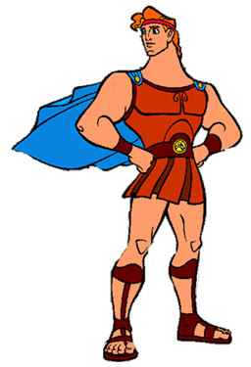
Part III: The Return
Hero is ready to return home and claim his true place as hero
The Return Home
The Mastery of Two Worlds
This Photo by Unknown Author is licensed under CC BY-NC-ND

Slide 18
The return home
Prove himself/herself a changed person

Slide 19
The Mastery of Two worlds
Ability to reconcile his/her experiences on the journey with his/her life back home
He has seen and learned things that have changed him/her
How can he/she continue to live in the world he/she used to live in but still stay true to his/her new role as a hero?
Not all heroes can do this!

